Slide 1
Contacts application

Slide 2
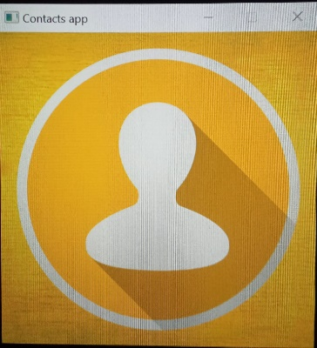
START WINDOW (Contacts icon) 512*512 pixels

Slide 3
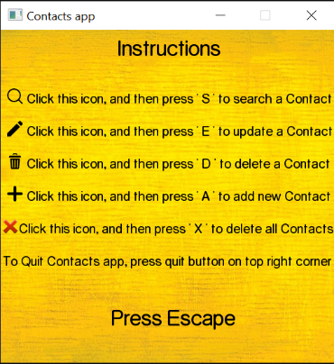
INSTRUCTIONS

Slide 4
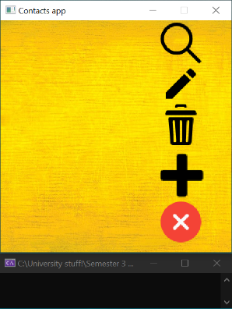
So How DOES our application looks?
No contacts once you run this application for the first time.
You can minimize app.
Don’t want to add any contact, just close it, program will end successfully.
Search button
Edit button
Delete selective contacts button.
Add a new contact button.
Delete all contacts button.
Black screen at bottom, is for input purposes.

Slide 5
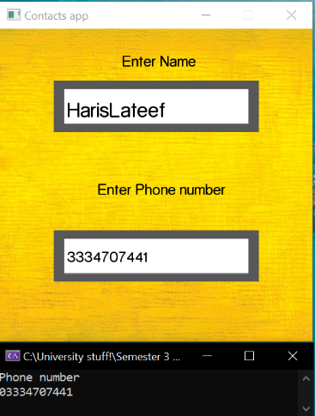
Add a CONTACT
This feature adds a new phone record to the file.
It asks for the phone number and name of the person whose record is to be created.

Slide 6
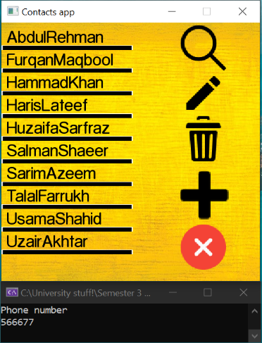
Display all Contacts alphabetically, once added
Upon successful creation of a new phone record, the Contacts program displays all contacts in sorted manner.
Each contact name is separated by a line.
Note that buttons are still available so, user can modify his/her records anytime.

Slide 7

What happens if same Contact is added again?
If the new phone record already exists in the file, an error message pop’s out -> “Contact already exists! Try again...”

Slide 8
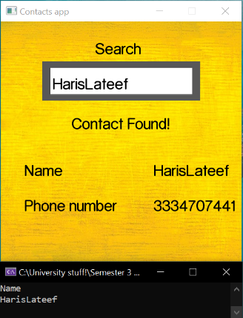
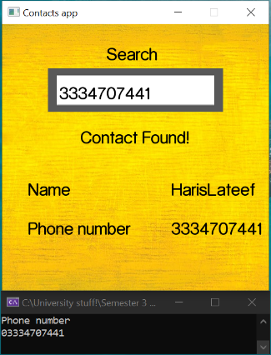
Want to SEARCH A CONTACT?
This function is very simple, and with it users can search for a phone record either by providing the phone number or by the name of a particular person whose record has already been added in the file.
Upon successful search, it displays the message -> “Contact found!”

Slide 9
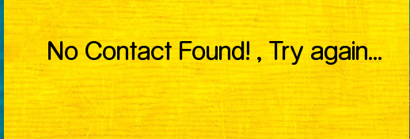
WHAT HAPPENS IF Wrong Name/Phone no IS entered To search?
Program displays message “No Contact found!, Try again….”, if wrong name or phone number is entered.

Slide 10
Modify any saved CONTACT
This simple feature allows user to edit the phone number and person name corresponding to a particular phone record.
User has to enter name of contact which needs modification.
Upon successful modification, the program updates existed contact, it can be a new name and will appear on screen in place of previous contact

Slide 11
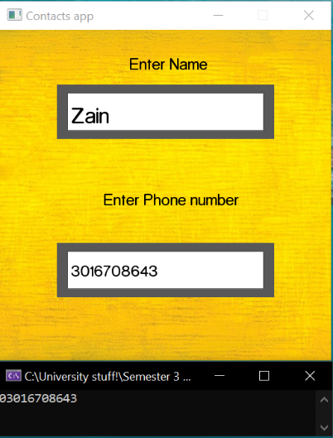
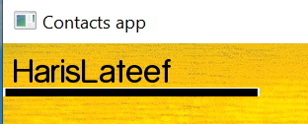
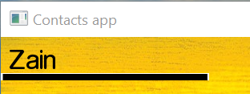
EXAMPLE
Haris Lateef contact is updated to new contact name Zain

Slide 12
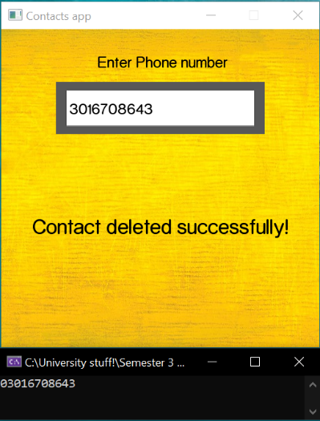
Want to DELETE A CONTACT?
This feature deletes added phone record from the file.
The user needs to provide the phone number to be deleted from Contacts.
Upon successful deletion, it displays the message -> “Contact deleted successfully!”.

Slide 13

Delete all contacts
A very simple and useful feature, which allows user to just press cross button, to delete all records in our Contacts management system.
Upon successful deletion, the program displays the message -> “All Contacts deleted successfully!”.

Slide 14
Reference
Visual Studio Community (2019)
https://visualstudio.microsoft.com/downloads/
Textures and Sprites
https://www.flaticon.com/
https://icons8.com/
SFML Graphics
https://www.youtube.com/watch?v=BySDfVNljG8&list=PL6xSOsbVA1eb_QqMTTcql_3PdOiE928up
https://www.youtube.com/watch?v=yEiZalvDOj4&list=PL6xSOsbVA1eaJnHo_O6uB4qU8LZWzzKdo

Slide 15
Group Members
Name | CMS_ID
Haris Lateef | 287137
Muhammad Uzair Akhtar | 283723
Muhammad Sarim Azeem | 285825

Slide 16


